Slide 1
Linear Data Structures
Static and Dynamic Implementation
A
D
T
A
D | A | T | A
SoftUni Team
Technical Trainers
Software University
https://softuni.bg

Slide 2
Table of Contents
Dynamic Arrays
List – Static Implementation
Nodes
Stacks
Linked/Dynamic Implementation
Queues
Linked/Dynamic Implementation
Linked Lists
SinglyLinkedList

Slide 3
Have a Question?
QA Sessions sli.do
#ds-csharp

Slide 4
Dynamic Arrays
0
1
2
0
1
2
3
Lists

Slide 5
Dynamic Arrays – List
List is the implementation of ADS List
Built atop an array, which is able to dynamically grow and shrink as you add/remove elements
Stores the elements inside an array
public class List<T> : IAbstractList<T>
{ private T[] items; }
Notes:
You can find the definition of ‘IAbstractList<T>’ in the provided Skeleton.

Slide 6
List – Operations
Supported operations and complexity:
Count, Get and Set through indexer - O(1)
Add(T item)
The operation runs in amortized constant time
Adding n elements requires O(n) time

Slide 7
List – Operations (2)
All of the other operations like:
Insert(int index, T item)
Contains(T item)
IndexOf(T item)
Remove(T item)
RemoveAt(int index)
Run in linear time O(n)

Slide 8
List – Add O(n)
Implemented using an array
Adding new item requires new array
This approach will copy all the elements for each add operation – O(n)
73 | 13 | 42 | 69
Add(21)
73 | 13 | 42 | 69 | 21
size = 4
size = 5
Out of space

Slide 9
List – Add O(1)
When adding, if needed double the size
This approach will copy at log(n) → n = 10⁹, only ~33 copies – O(1) amortized
Add( )
73 | 13 | 42 | 69
21
73 | 13 | 42 | 69
size = 4
size = 8
Out of space

Slide 10
Problem: List
Create a List<T> data structure
void Add(T element)
Get and Set operations through an indexer
int Count { get; }
bool Remove(T item)
void RemoveAt(int index)
int IndexOf(T item)

Slide 11
List – Constructor and Fields
Constructor and fields:
public class List<T> : IList<T>
{
private const int DEFAULT_CAPACITY = 4; private T[] elements; private int size;
public List()
{ this.elements = new T[DEFAULT_CAPACITY]; }
}

Slide 12
List – Add
Adds an element after the last element:
public void Add(T item)
{
if(this.size == this.elements.Length)
{
this.elements = this.Grow();
}
this.elements[this.size] = item;
this.size++;
}

Slide 13
Indexer
public T this[int index]
{ get
{
this.ValidateIndex(index);
return this.elements[index];
}
set
{
this.ValidateIndex(index);
this.elements[index] = value;
}
}

Slide 14
List – RemoveAt
Removes an element at the specified:
public void RemoveAt(int index)
{ this.ValidateIndex(index);
this.Shift(index);
this.size--; }

Slide 15
Helper Methods – Grow and Shrink
private T[] Grow()
{
T[] newArray = new T[this.elements.Length * 2];
Array.Copy(this.elements, newArray, this.elements.length);
return newArray;
}
private T[] Shrink()
{ T[] newArray = new T[this.elements.Length / 2];
// To Do: Implement this on your own }

Slide 16
List – Other Operations
IndexOf(T item)
Returns the zero based index of an element or -1
Contains(T item)
Returns whether an element is present
Count
Returns the number of elements
ToArray()
Returns the elements as an array

Slide 17
Nodes
Node
Pointer
Value
Building Block

Slide 18
Node Class
The Node class is the build block for many data structures
Inside Node object we store an element and pointer to the next node at least
public class Node<T>
{ public T Element { get; set; } public Node<T> Next { get; set; } }

Slide 19
Node – Application
Many data structures use node chaining
public class LinkedList<T> : IAbstractList<T>
{ private Node<E> head;
}
head
element
next
Node₁
element
next
Node_{n-1}
element
next
null
address
next
2
address
next
5
Notes:
The LinkedList implementation in C# uses double-linked nodes.

Slide 20
Problem: Node
Create a class Node<T>, that has:
T Element
Node<T> Next
Constructor
public class Node<T> { public T Element { get; set; } public Node<T> Next { get; set; } public Node(T value) { this.Element = value; } }

Slide 21
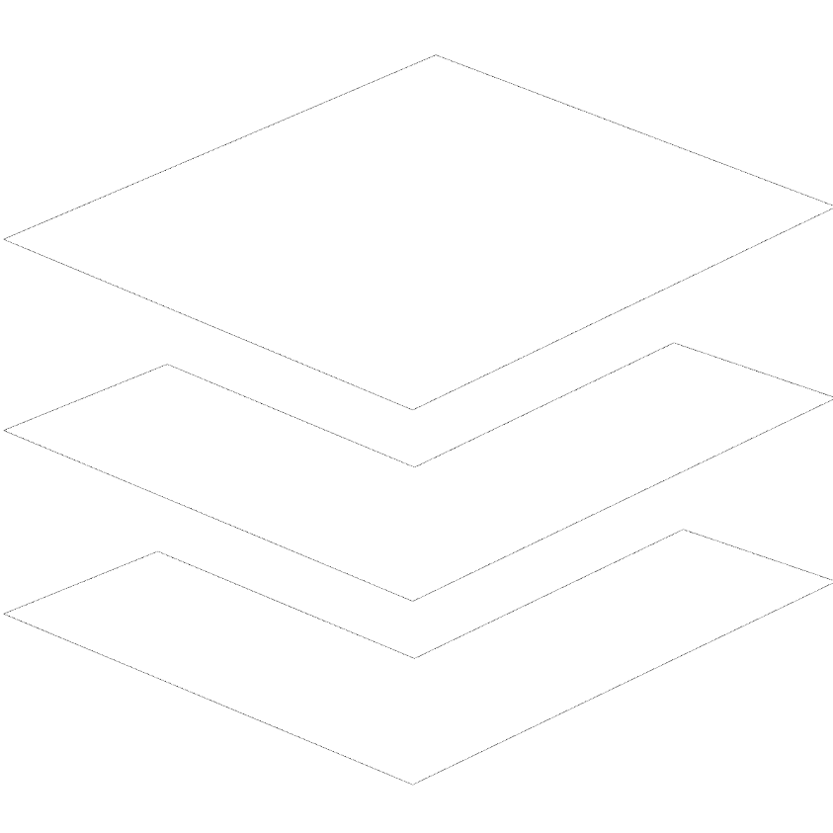
Stacks
Dynamic Implementation

Slide 22
Stack
Stack is the implementation of ADS LIFO
Last In First Out
Build by using Node class or atop an array
Stack example using Node
public class Stack<T> : IAbstractStack<T>
{ private Node<T> top; private int size;
}
Notes:
You can find the definition of ‘IAbstractStack<T>’ in the provided Skeleton.

Slide 23
Stack – Operations
Supported operations and complexity:
Count, Push(T item), Pop(), Peek() – O(1)
All other operations run in linear time – O(n)
CopyTo(T[] array, int arrayIndex)
Contains(T item)
etc…

Slide 24
Stack – Push
Chain the nodes by using the top field:
new Node
new Node
A
B
C
Link
Link
top

Slide 25
Stack – Push
Add element at the top
Link the nodes and increment size
public void Push(T element)
{
var newNode = new Node<T>(element);
newNode.Next = top;
top = newNode;
this.size++;
}

Slide 26
Stack – Pop
Remove the top Node and return the element
Unlink the nodes and decrease size
Save previous
Save previous
null
A
B
Unlink
Unlink
top

Slide 27
Stack – Pop
Remove and return element at the top:
public T Pop()
{
// To Do: Implement on your own }

Slide 28
Queues
6
5
4
3
2
1
Dynamic Implementation

Slide 29
Queue
Queue is the implementation of ADS FIFO
First In First Out
Build by using Node class or atop an array
Queue example using Node
public class Queue<T> : IAbstractQueue<T>
{ private Node<T> head; private int size;
}
Notes:
You can find the definition of ‘IAbstractQueue<T>’ in the provided Skeleton.

Slide 30
Queue – Operations
Supported operations and complexity:
Count, Dequeue(), Peek() – O(1)
Enqueue(T item):
If we keep the reference to the that node – O(1)
If we have to chase pointers to that node – O(n)

Slide 31
Queue – Enqueue
Head == null
Size > 0
=> head = new Node
=> chain the nodes by adding new Node after the last one - the so-called tail:
new Node
new Node
A
B
C
Link
Link
head

Slide 32
Queue – Enqueue
Add element at the end – link the nodes and increase size
public void Enqueue(T element)
{ // To Do: Implement on your own }

Slide 33
Queue – Dequeue
Remove the head Node and return the element
Unlink the node and decrease size
Save previous
Save previous
Poll Last Left
B
null
A
C
unlink
unlink
head

Slide 34
Stack / Queue – Real-World Applications
Stack
Undo operations
Browser history
Chess game progress
Math expression evaluation
Implementation of function (method) calls
Tree-like structures traversal (DFS algorithm)
Queue
Operation system process scheduling
Resource sharing
Printer document queue
Server requests queue
Tree-like structures traversal (BFS algorithm)

Slide 35
Linked Lists
Head
Next
Tail
SinglyLinkedList

Slide 36
SinglyLinkedLists
Linear data structure where each element is a separate object – Node
The elements are not stored at contiguous memory
The entry point is commonly the head of the list
public class SinglyLinkedList<T> : IAbstractLinkedList<T>
{ private Node<Т> head; private int size;
}

Slide 37
Singly Linked List – Operations
Supported operations and complexity:
AddFirst(T item), RemoveFirst(), GetFirst(), Count – O(1)
How about operations on the last element?
AddLast(), RemoveLast(), GetLast()
Depends if we keep the reference to the last node (DoublyLinkedList) or not can be constant – O(1) or linear – O(n)
Operations that index into the list will run in linear time O(n)

Slide 38
Singly Linked List – Adding Last
Same as Queue – Enqueue
new Node
new Node
A
B
C
Link
Link
head

Slide 39
Singly Linked List – Adding First
Same as Stack – Push
new Node
new Node
C
B
A
Link
Link
head

Slide 40
Linked List – Removing First/Last
Size == 0 → Do Nothing / Throw Exception
Size == 1 → head = null
Size > 1
Save old Head
Set new Head
Previous Node
A
B
C
Unlink
Unlink
Delete
head
Delete
last

Slide 41
Node Implementation
We have implemented some Data Structures
Node class properties
However the way we did it introduces some performance problems when chaining nodes.
Can we solve them?
Add/Remove/Get in constant time?
We will try to understand and solve those problems at the exercise.

Slide 42

Summary
…
…
…
Stack is LIFO structure (Last In First Out)
Linked implementation is pointer-based
Queue is FIFO (First In First Out) structure
Linked implementation is pointer-based
SinglyLinkedList
Linked implementation is pointer-based

Slide 43













SoftUni Diamond Partners

Slide 44


Educational Partners

Slide 45
Questions?
Notes:
45

Slide 46

License
This course (slides, examples, demos, exercises, homework, documents, videos and other assets) is copyrighted content
Unauthorized copy, reproduction or use is illegal
© SoftUni – https://about.softuni.bg/
© Software University – https://softuni.bg
Notes:
46

Slide 47
Trainings @ Software University (SoftUni)
Software University – High-Quality Education, Profession and Job for Software Developers
softuni.bg, about.softuni.bg
Software University Foundation
softuni.foundation
Software University @ Facebook
facebook.com/SoftwareUniversity
Software University Forums
forum.softuni.bg
Notes:
47

